Slide 1
Engineering Project Portfolio
Kenneth Khong
University of Florida | Mechanical Engineering
Bachelors of Science 2022 | 2026
Masters of Science 2026 | 2027

Slide 2

Hello!
Thank you for viewing my Project Portfolio!
Here’s some contact info

Slide 3
Phone:
407-719-7851
LinkedIn:
https://www.linkedin.com/kenneth-khong
Email:
kennethkhong04@gmail.com
GitHub:
https://github.com/KennethK24

Slide 4


How this works…
The introduction and background of the project is given in the first slide.
The second slide/page will be the images and renders of the project, if available.
Click this to go to the first page of each project

Slide 5
Table of Contents:
Ctrl + Click me to go to each project!
Front Bellcrank Clevis Design
Structural Dynamics Project
Structural Optimization Project
Senior Design Project
Computer Cart Assembly
Dynamics and System Controls Design Laboratory

Slide 6
Front Bellcrank Clevis Design
Back to Table of Contents
Formula Student – Suspension System

Slide 7
New Design Cycle – New Suspension Geometry
The F24 car was Gatormotor Sports’s first electric car in the team’s history:
New full carbon fiber monocoque chassis
Required all suspension parts to have new geometries due to new chassis kinematic geometries
My project goal:
Develop a bellcrank clevis geometry that was compliant with the loading cases following the 2.5 FoS and the new kinematic geometry.

Slide 8
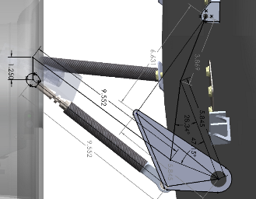
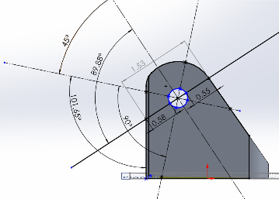
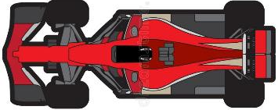
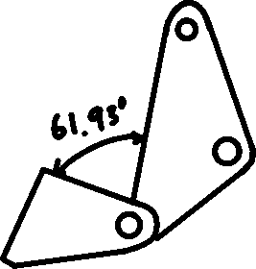
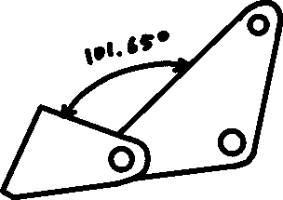
Front Bellcrank Clevis
At rest
Shock/damper Pivot Point
Center of hole aligns here
Pullrod
Tire
Bellcrank
After 1264 lb shock force, using 350 lb/in springs
Pullrod Pivot Point
Relative location in car
Clevis Pivot Point

Slide 9
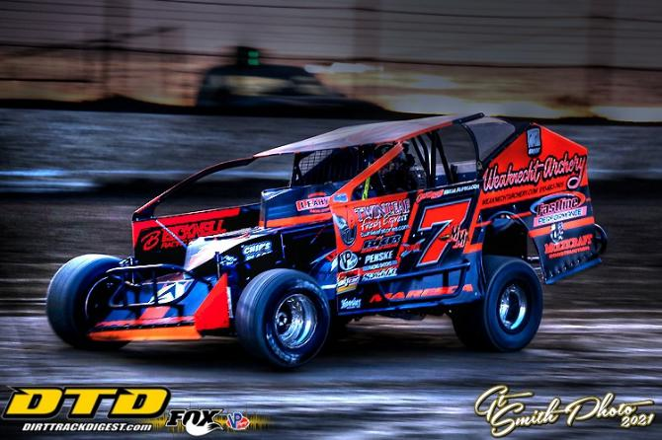
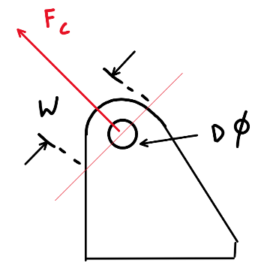
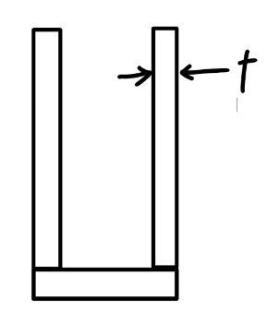
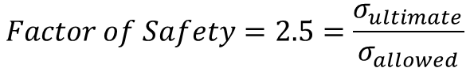
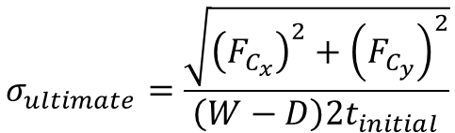
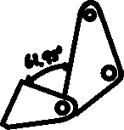
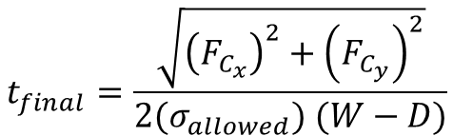
Loading Case - Spinout
$$σ_{ultimate}=\frac{\sqrt{{\left(F_{C_{x}}\right)}^{2}+{\left(F_{C_{y}}\right)}^{2}}}{\left(W−D\right)2t_{initial}}$$
(1)
$$Factor of Safety=2.5=\frac{σ_{ultimate}}{σ_{allowed}}$$
(2)
Side View
Visual example of how turning hard results in weight transfer to be concentrated on the outside turning tire. The photo shows a left-hand turning scenario.
$$t_{final}=\frac{\sqrt{{\left(F_{C_{x}}\right)}^{2}+{\left(F_{C_{y}}\right)}^{2}}}{2(σ_{allowed}) (W−D)}$$
(3)
Front View

Slide 10
Structural Dynamics Project
Back to Table of Contents
Course Project

Slide 11
Piezoelectrics on a Cantilever Beam
Part 1:
Create a finite element model of the beam with the piezoelectric actuators
Part 2:
Experimental Modal Analysis
Part 3:
Compare the finite element model with the experimental data

Slide 12
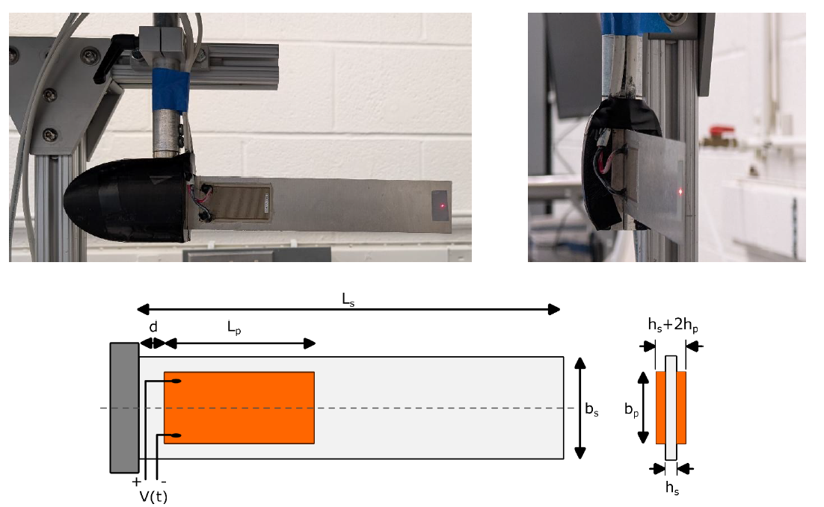
Cantilever Beam with Piezoelectric Attached
The piezoelectric actuators excite the beam to induce a displacement on the cantilever beam.
The orange rectangle in the diagram represents the piezoelectric that is bonded to the aluminum cantilever beam.

Slide 13
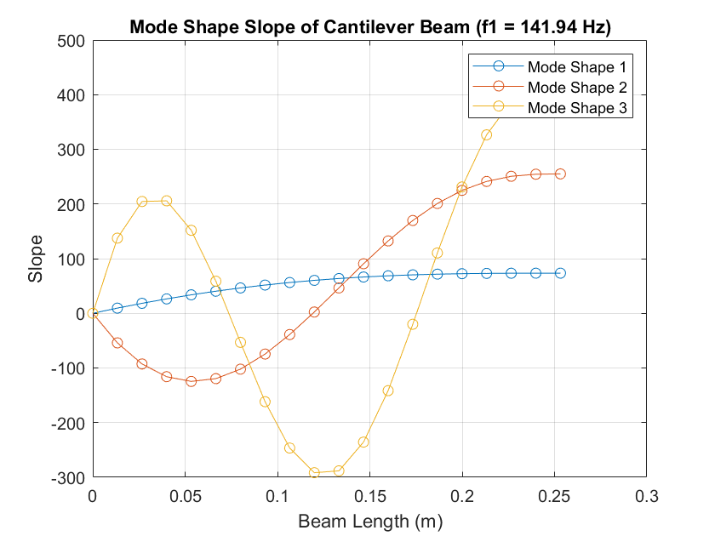
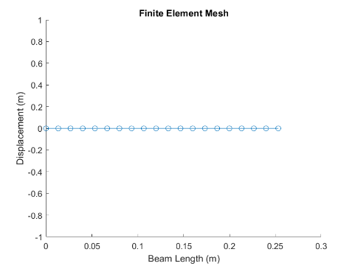
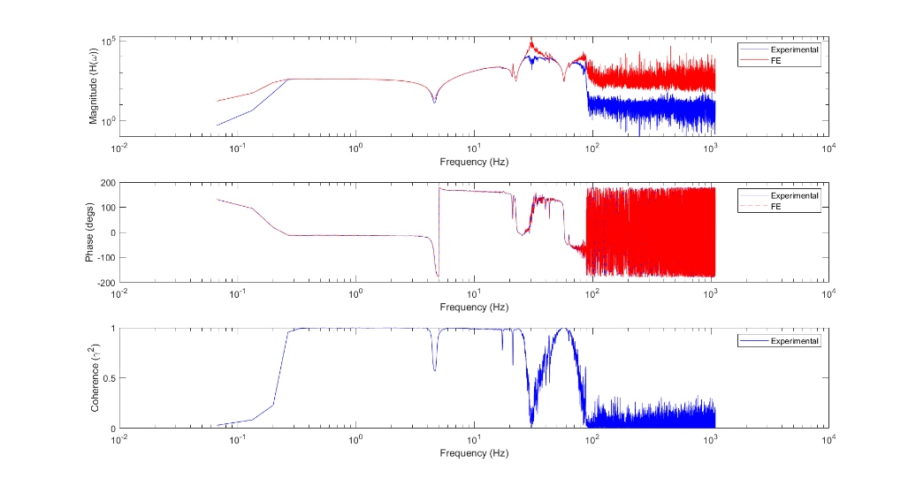
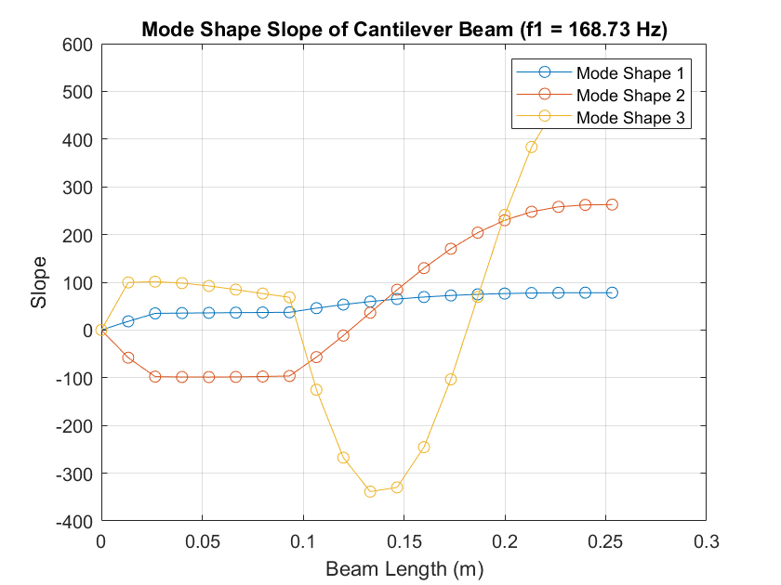
MATLAB Finite Element Model
Finite Element Mesh in MATLAB
Mode Shape of Beam without piezoelectric actuators
Frequency Response Function (FRF):
Experimental Data FRF results vs FE Beam FRF results
Mode Shape of Beam with piezoelectric actuators

Slide 14
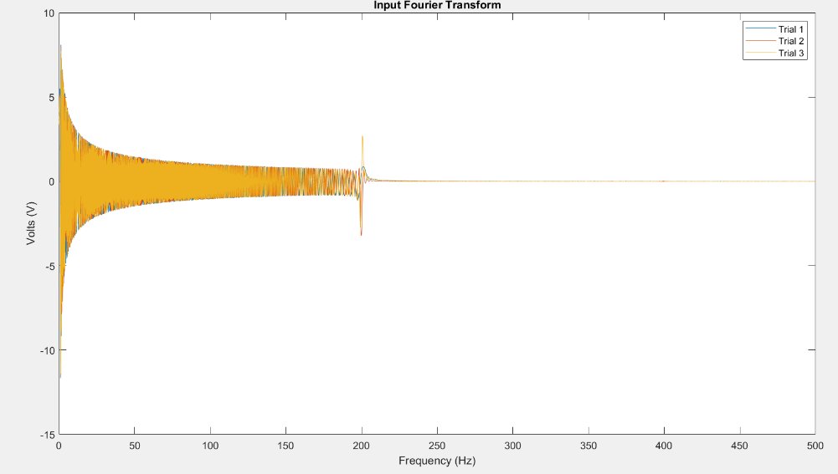
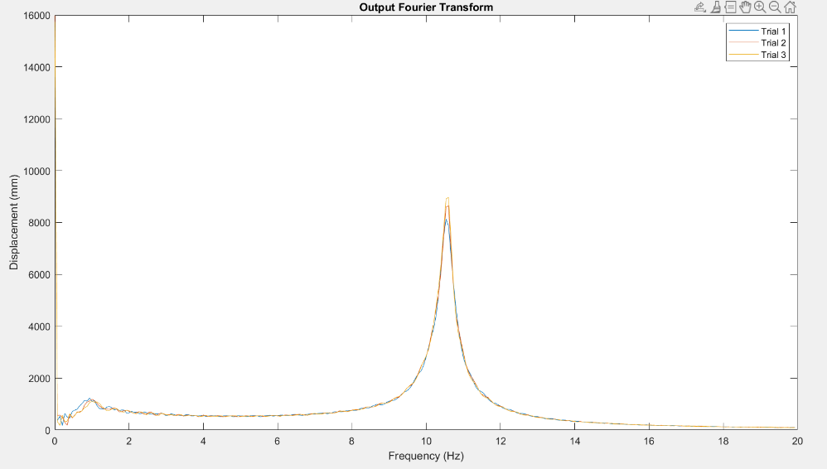
Input Fourier Transform - Dominant Frequency ~ 200 Hz
Output Fourier Transform – Dominant Frequency ~ 10.5 Hz

Slide 15
Structural Optimization Project
Back to Table of Contents
Course Project

Slide 16
Structural Optimization of a MBB half beam
Part 1:
Use O. Sigmund’s 99-line Topology Optimization MATLAB code to find the initial topology optimized MBB geometry.
Part 2:
Put the topology optimized structure into ANSYS Static Structural (FEA), select four design parameters to change
Optimizing for weight savings and meeting the maximum stress requirements.
Run the simulation multiple times with varying design parameter values to find as many different outputs as possible to understand what each design parameter change results in.
Part 3:
Take the calculated outputs from the FEA simulations and create a surrogate model (Kriging and Polynomial Surface Response) to find design parameters that result in the desired outputs, using the previously calculated data with random inputs.

Slide 17

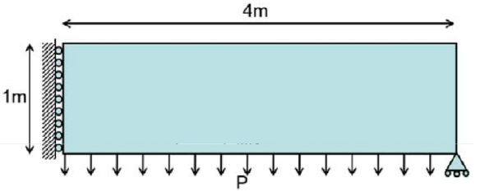


Initial MBB Half Beam Geometry and Topology Optimized Geometry
Topology Optimized: 40x10 Mesh Size
Topology Optimized: 80x20 Mesh Size
Messerschmitt-Bölkow-Blohm (MBB) Half Beam
Topology Optimized: 160x40 Mesh Size

Slide 18
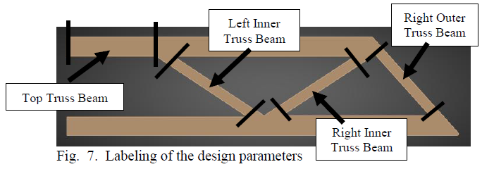
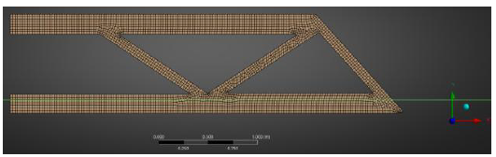
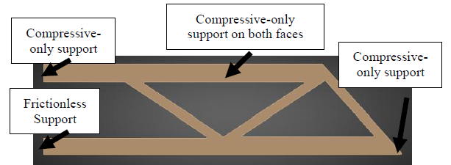
ANSYS Static Structural FEA Geometry
Chosen Design Parameters for Weight Savings and Stress Requirements
Meshing of Topology Optimized FEA Geometry
Placements of Supports in FEA

Slide 19
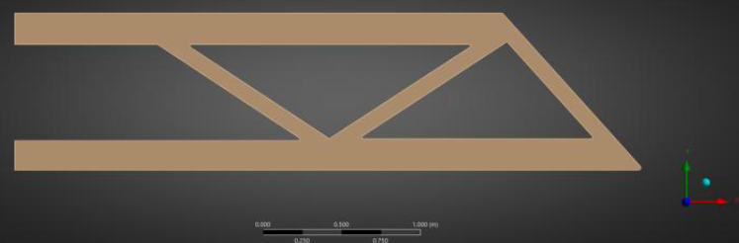
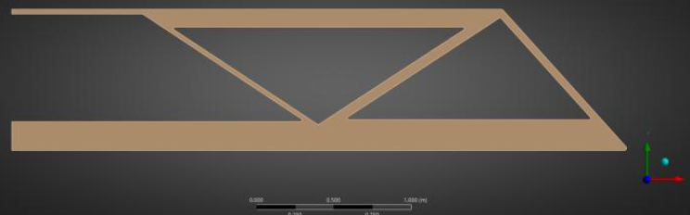
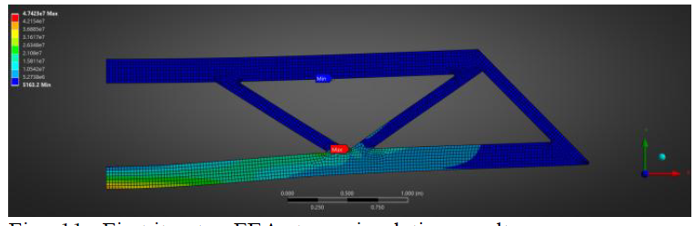
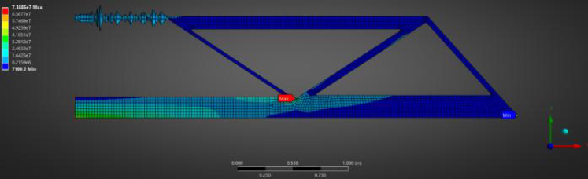
ANSYS Static Structural FEA Results
Initial FEA Geometry
Final FEA Geometry
Initial FEA results with distributed force all the length of the bottom edge
Final FEA results with distributed force all the length of the bottom edge

Slide 20
Computer Cart Assembly
Back to Table of Contents
Research Lab Equipment Upgrade

Slide 21
AI Biomechanics Laboratory
The AI Biomechanics Laboratory required extensive modification of the computer cart for purposes of providing protect to the sensitive and fragile equipment during transportation.
The project tasks were to:
Provide an enclosure for the computer equipment from:
Blunt impacts
Environmental damage (water, dust, sharp objects)
The enclosure should be:
Easily removable for maintenance
Allow easy access to the computer components with removing many parts
Provide a place for tools to be placed on

Slide 22
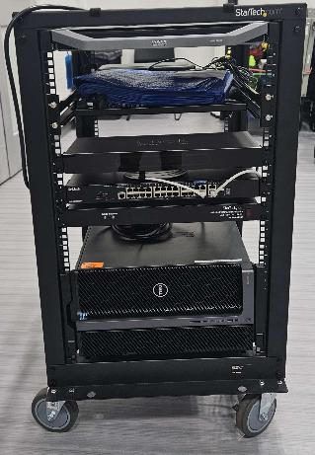
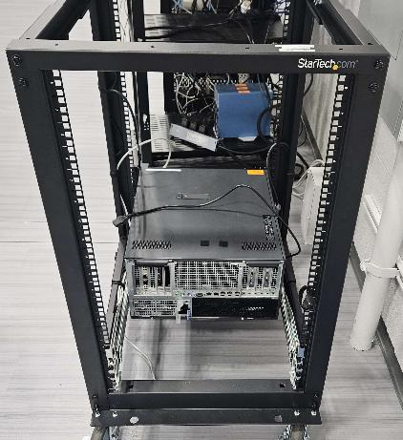
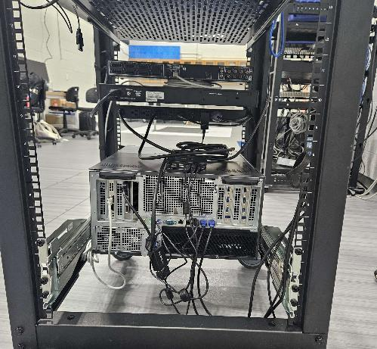
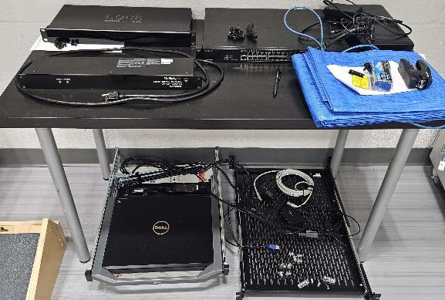
Computer Cart – Before
Image with shelves, Keyboard, Mouse, & Monitor (KMM) Consoles, and computer equipment
Image without shelves, Keyboard, Mouse, & Monitor (KMM) Consoles, and computer equipment
Components of the computer cart

Slide 23
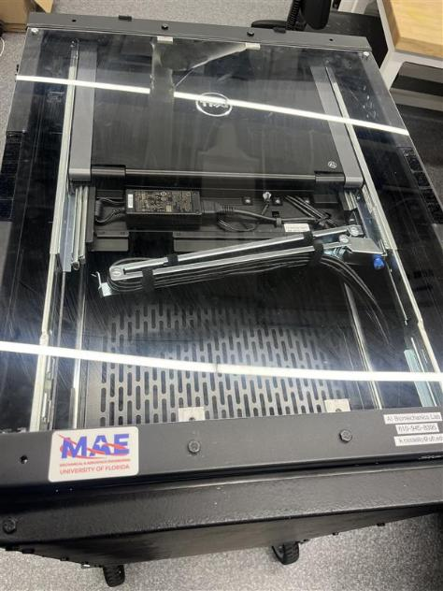
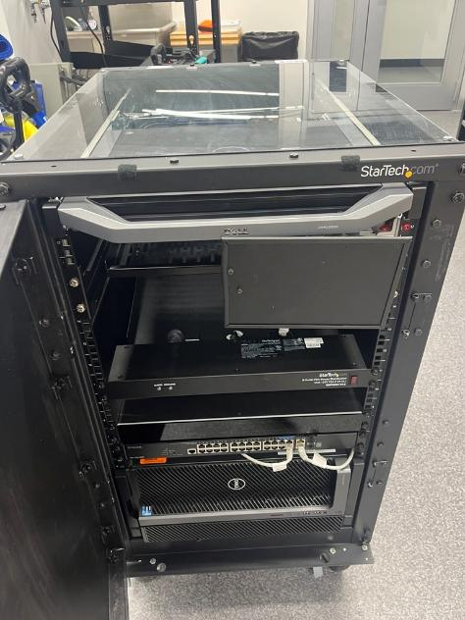
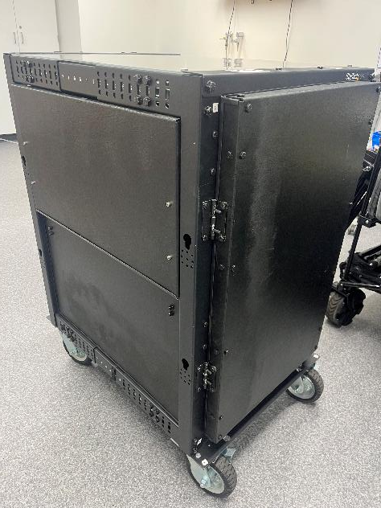
Computer Cart – After
Side view with fold up doors that double as tables and allow access into the computer cart
Front view of main computer and monitor access with mousepad, and swiveling door with dual swing capability for convenience
Top View of cart with polycarbonate sheet

Slide 24
Senior Design Project
Back to Table of Contents
Course Project

Slide 25
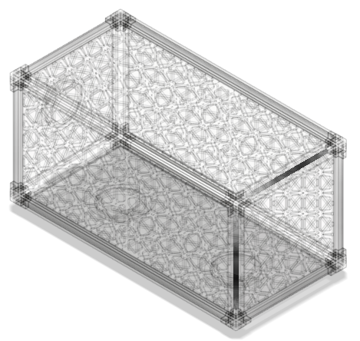
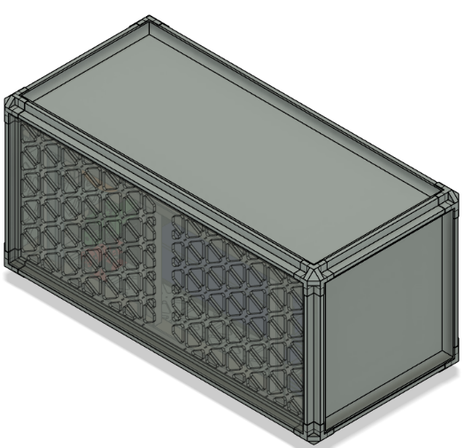
Bosuns Locker Challenge
The Arkisys’ Bosuns Lockers are enclosures that house payloads and In-space Servicing, Assembly, and Manufacturing (ISAM) activities.
The Arkisys’ Bosuns Lockers are part of the Arkisys’ Port Module spacecraft, which is a long duration spacecraft platform that supplies data, power, thermal, momentum, and other services for Bosuns lockers.
The project challenge required creating a manufacturing process with three or more discrete operations providing a capability important for orbital manufacturing or assembly.
Above: A transparent Bosuns Locker model in CAD
Below: A Bosuns Locker with one side panel made transparent to show the interior with the assembly

Slide 26
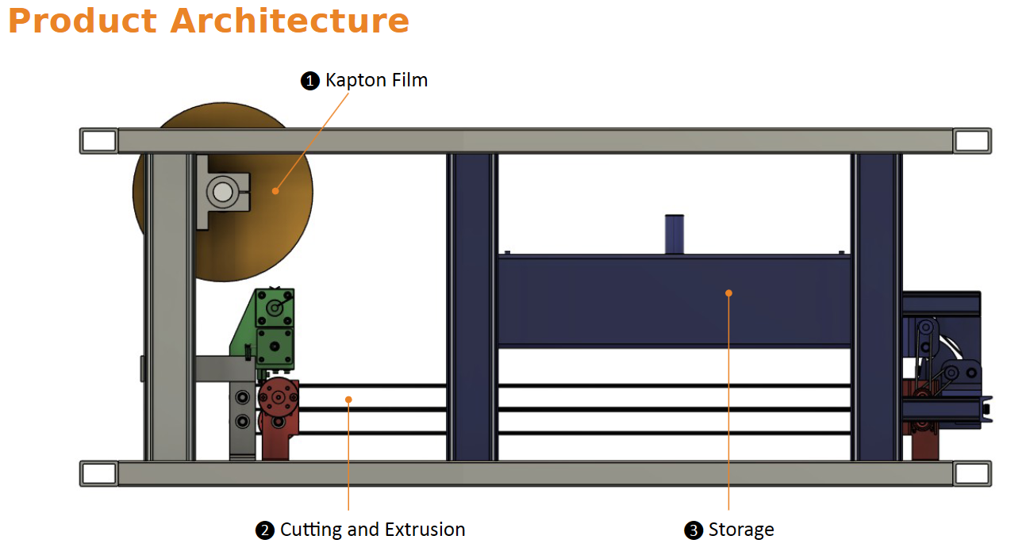
Overall Manufacturing Process

Slide 27
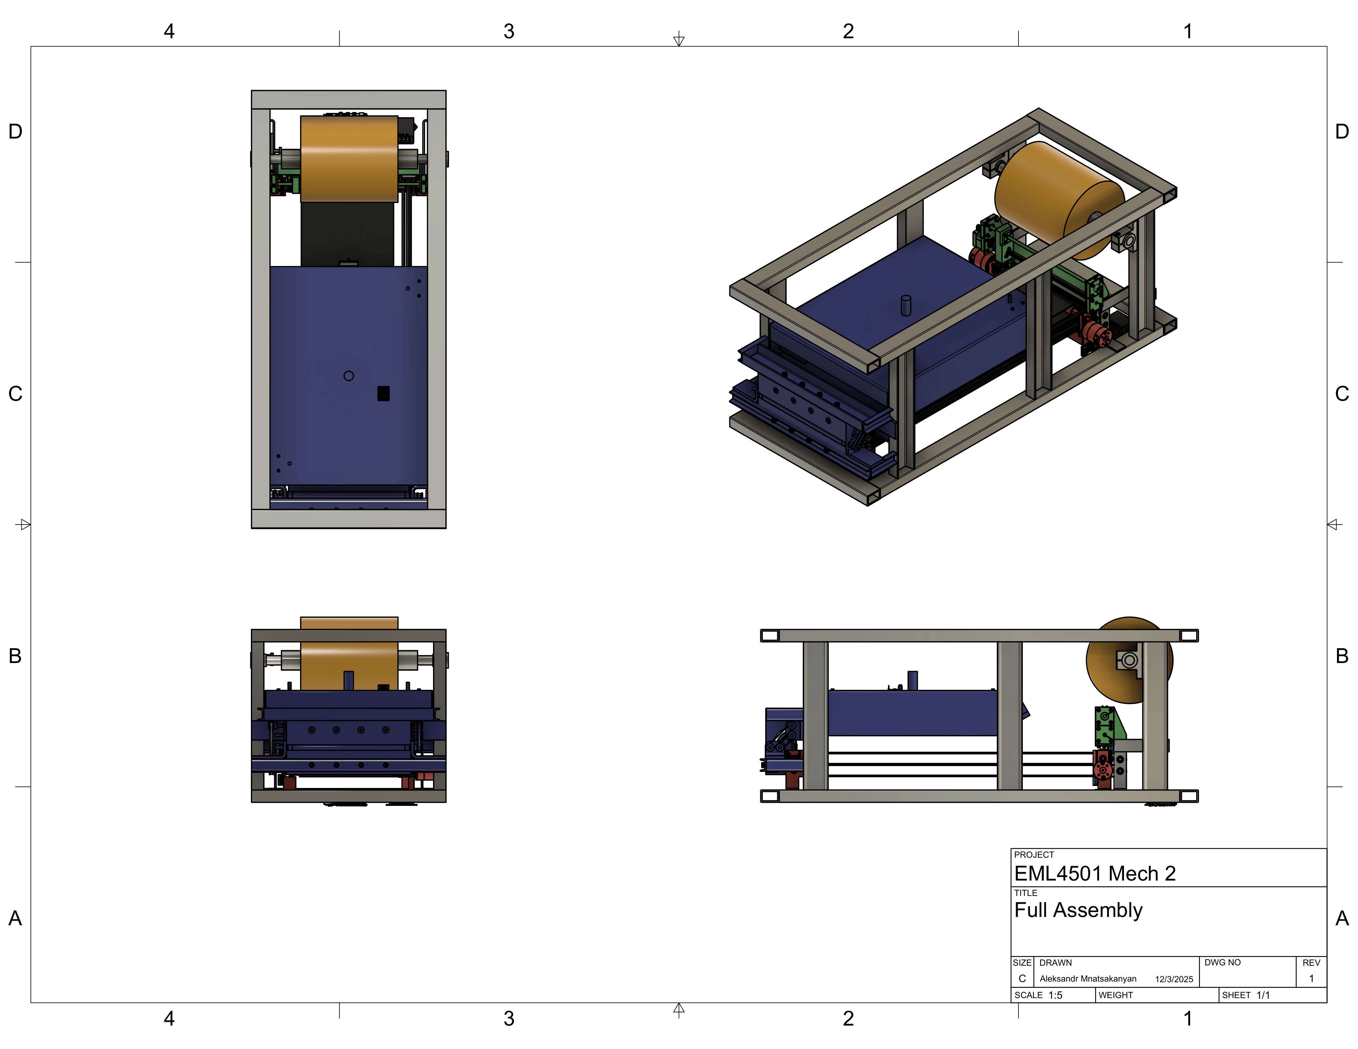
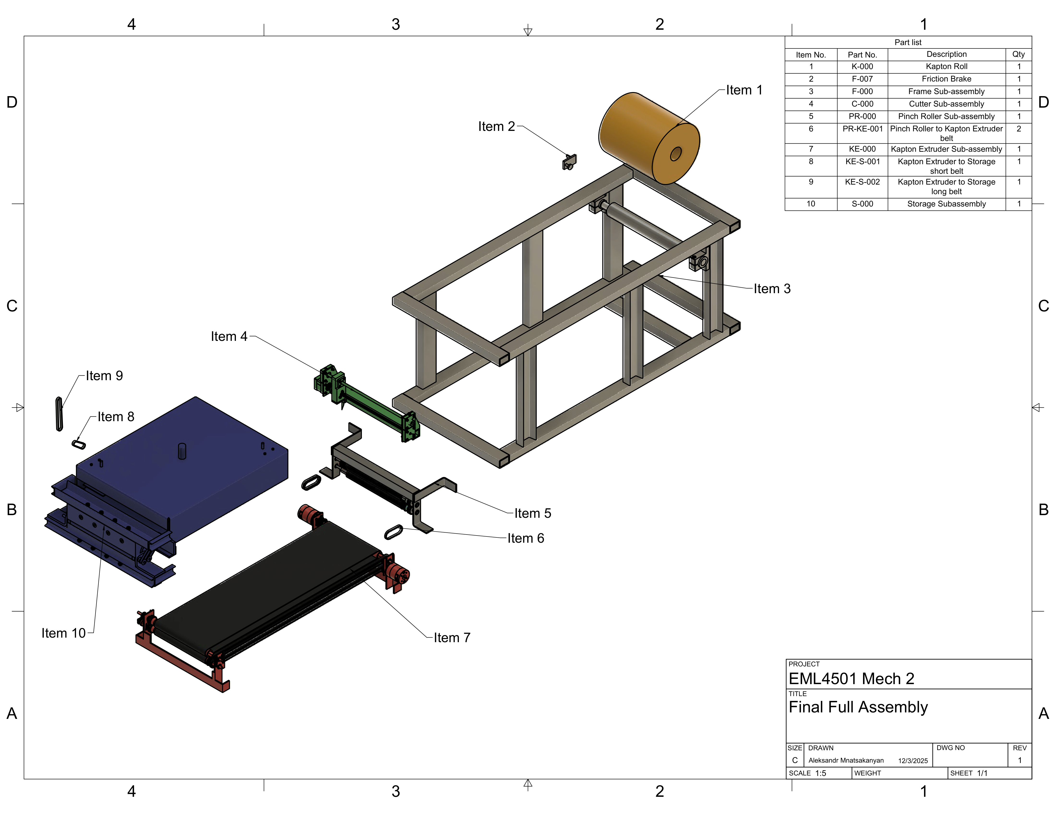
Overall Manufacturing Process - Drawings

Slide 28
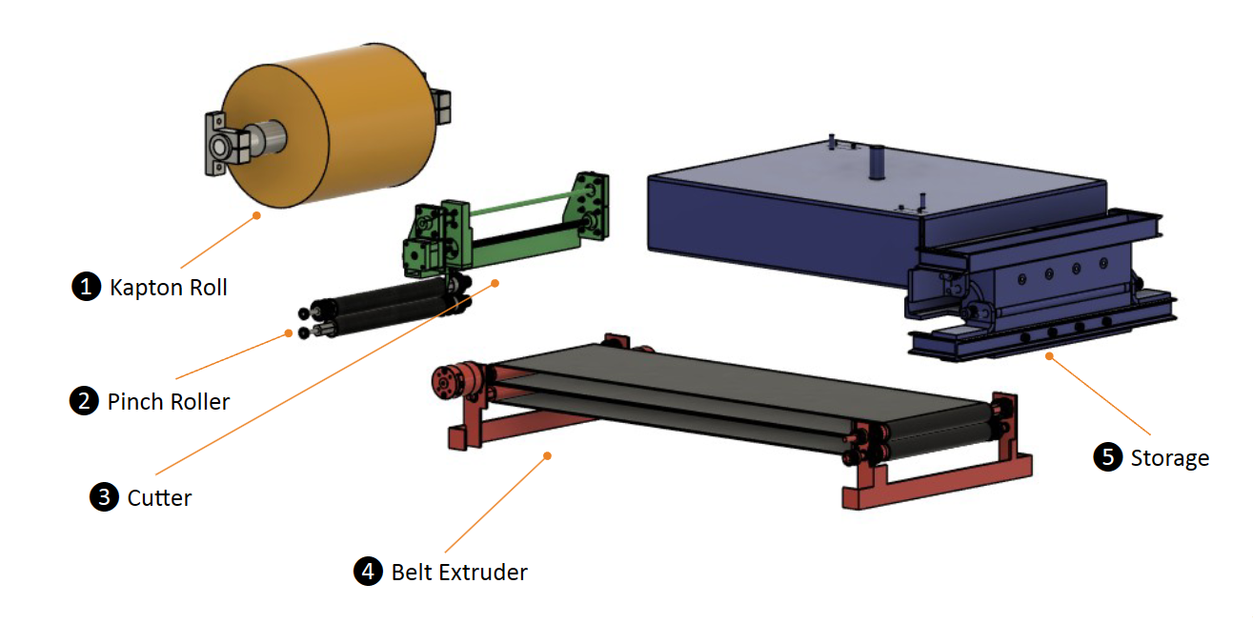
Overall Manufacturing Process

Slide 29
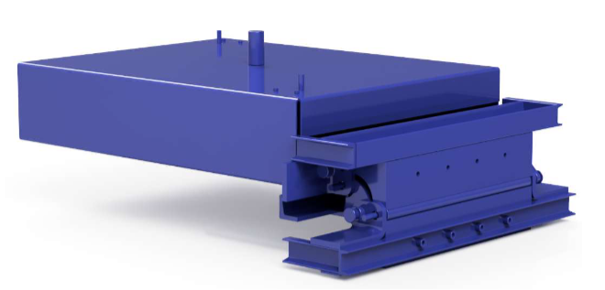
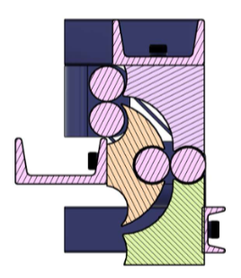
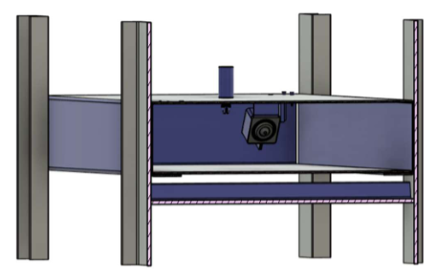
Kapton Film Storage
Film Storage Guides
Film Storage

Slide 30
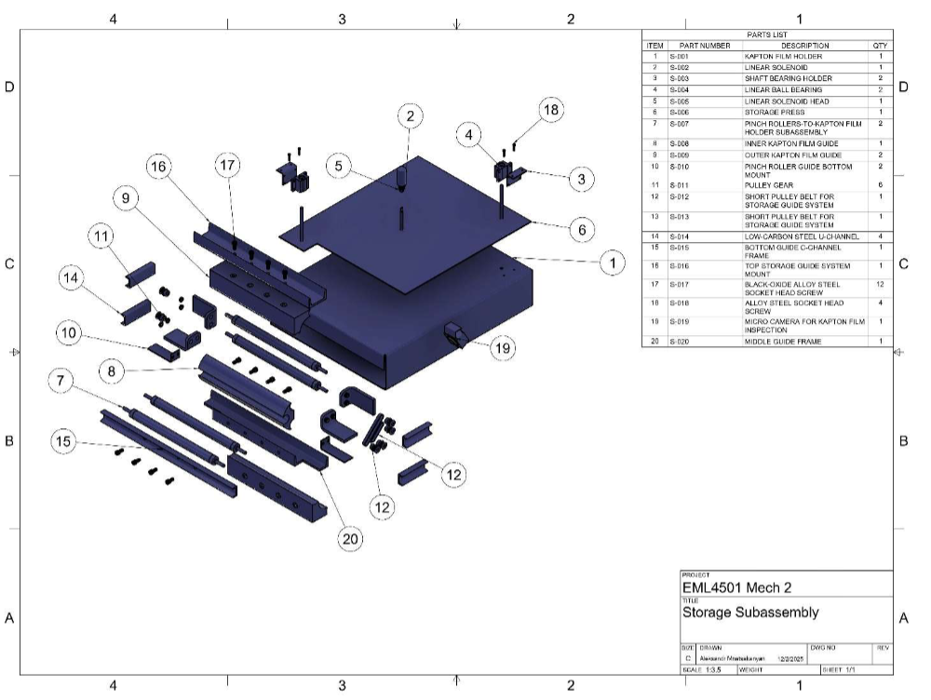
Kapton Film Storage - Drawings

Slide 31
Dynamics and System Controls Design Laboratory
Back to Table of Contents
Laboratory Course

Slide 32
Course Background and Projects
This course taught the application of control system theory to model and characterize dynamic systems and create Single-input-single-output (SISO) and multiple-input-multiple-output (MIMO) control systems using classical and state-space control methods.
Lab 1: Developing Models of a Motor/Flywheel System
Lab 2: Bang-Bang, PID and Full-State Feedback
Lab 3: Parametrization of Furuta Pendulum System
Lab 4: Full-State Feedback Controller Design for Pendulum System

Slide 33
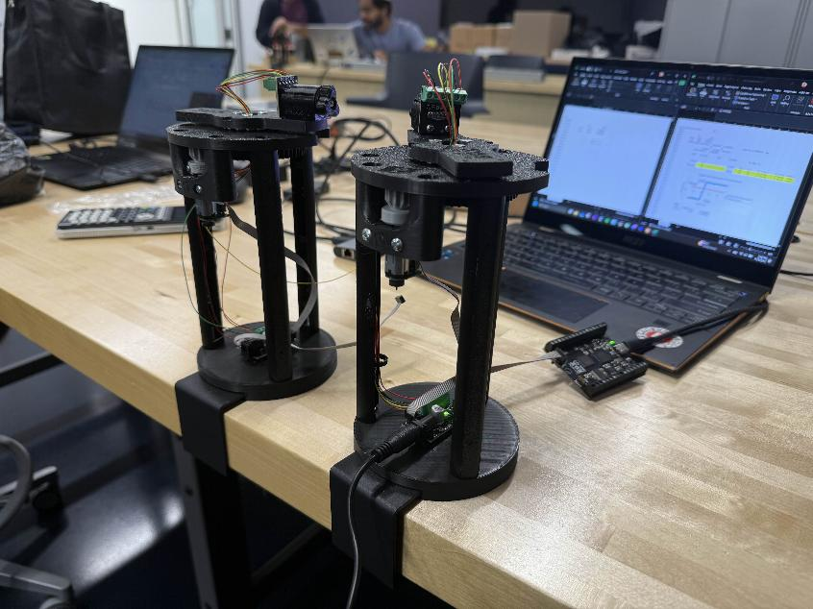
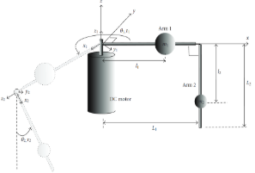
Lab Photos
Lab 4 Furuta Pendulum Model
Furuta Pendulum Setup

